Slide 1
Cardiovascular Disease Risk Prediction Using Machine Learning
Prepared by:
Malak Reda Abdelghani 231001933
Instructor: Mohamed Mahmoud Elsayeh

Slide 2
Problem & Objectives
Problem
Cardiovascular disease risk prediction, Binary classification, Predict: Disease / No Disease
Objectives
Clean and prepare the data, Train different ML models, Compare model performance, Select the best model

Slide 3
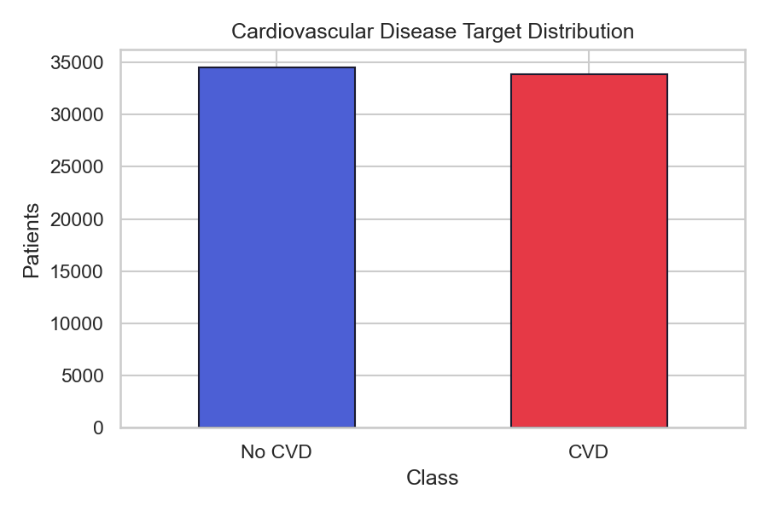
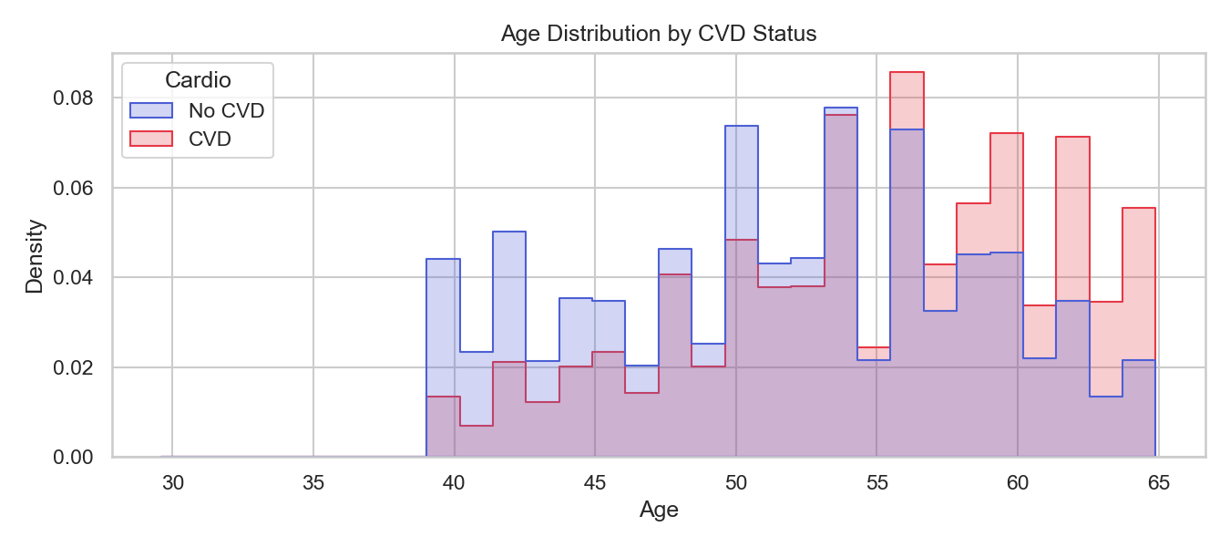
Dataset
Dataset
Main Features
Original records: 70,000
After cleaning: 68,359
17 features
Target variable: Cardio
Age
Gender
Height & Weight
Blood Pressure
Cholesterol
Glucose
Smoking
Physical Activity

Slide 4
Data Preprocessing & Feature Engineering
Data Preprocessing
Main Features
Remove unrealistic values
Convert age from days to years
Prepare categorical features
Age
Gender
Height & Weight
Blood Pressure
Cholesterol
Glucose
Smoking
Physical Activity

Slide 5
Machine Learning Models
Machine Learning Workflow
Data → Preprocessing → Feature Engineering → Model Training → Evaluation
Models Compared:
RBF SVM
KNN
XGBoost

Slide 6
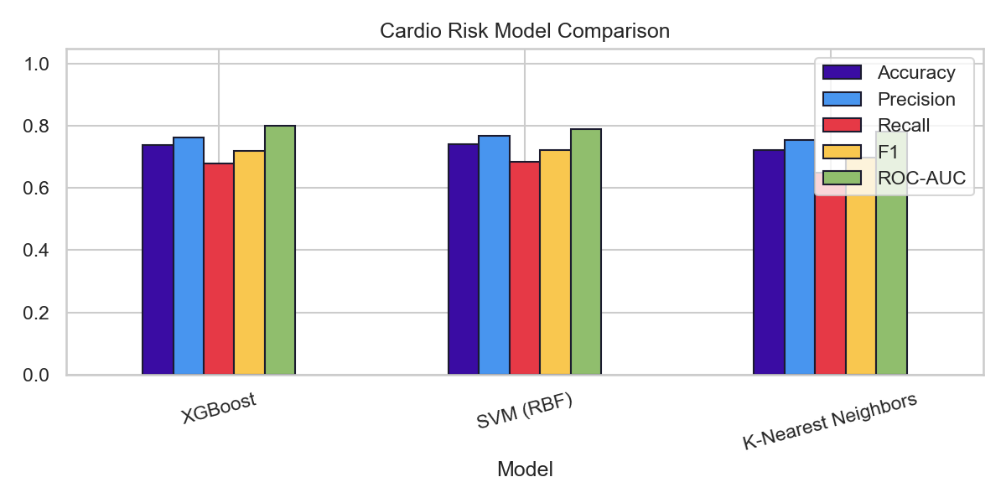
Results & Model Comparison
Model | Accuracy | F1-score
KNN | 72.2% | 69.8%
XGBoost | 73.8% | 72.0%
RBF SVM | 74.1% | 72.3%

Slide 7
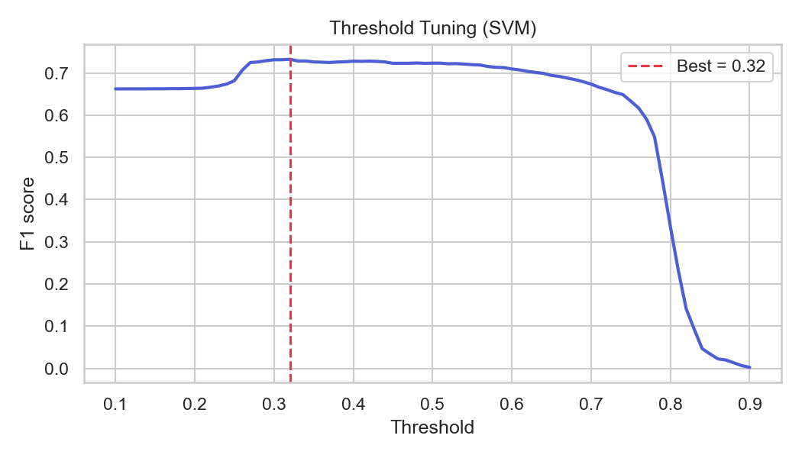
Threshold Tuning & Final Results
Final SVM Performance
Threshold
Accuracy: 72.27%
Precision: 70.12%
Recall: 76.63%
F1-score: 73.23%
ROC-AUC: 78.98%
Default: 0.50 → Optimized: 0.32

Slide 8
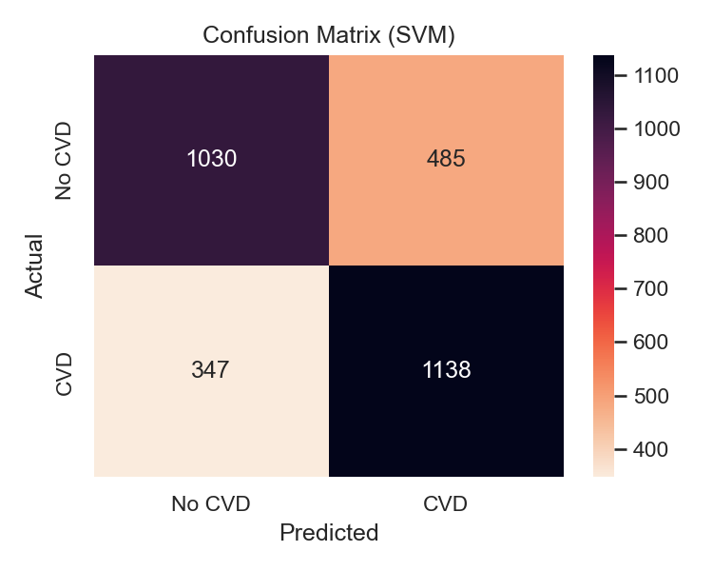
Conclusion & Discussion
Three ML models were compared
RBF SVM was selected
Optimal threshold: 0.32
Final F1-score: 73.23%
Final Recall: 76.63%
Limitation
Educational project
Not a clinical diagnostic tool

Slide 9
THANK YOU

